Slide 1

Big Mountain Resort
Data-driven ticket pricing strategy
Daniel Fugisawa

Slide 2
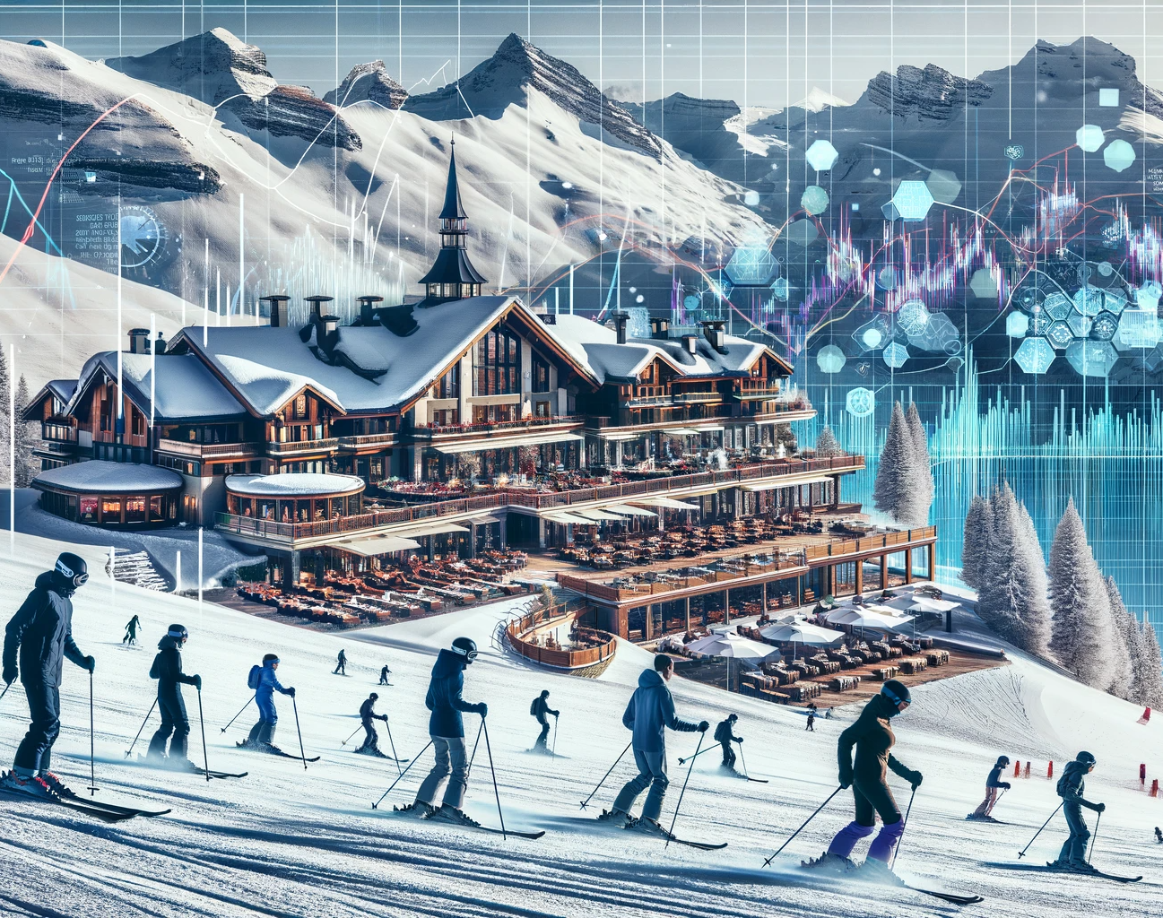
Problem Identification
Develop Big Mountain Resort’s data-driven ticket pricing strategy to reflect the added value of its new chair lift and premium facilities, aiming to offset the $1,540,000 increase in operating costs

Slide 3
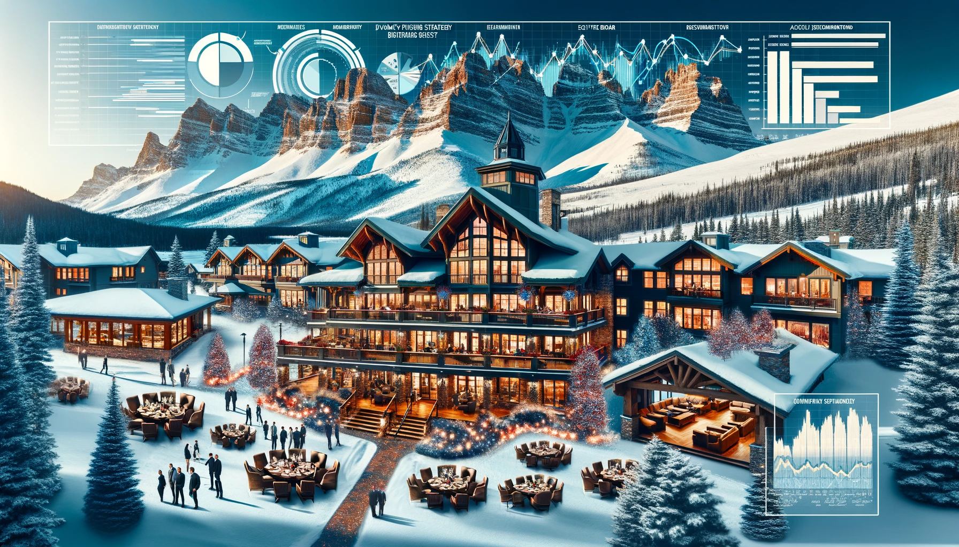
Recommendations and Key Findings

